Slide 1
Working with Databases
Chapter 14

Slide 2
Chapter 14
1
Databases and Web Development
2
SQL
3
4
NoSQL
Database APIs
5
Managing a MySQL Database
6
Accessing MySQL in PHP
7
8
Sample Database Techniques
Case Study Schemas

Slide 3
Chapter 14 cont.
9
Summary

Slide 4
Chapter 14
1
Databases and Web Development
2
SQL
3
4
NoSQL
Database APIs
5
Managing a MySQL Database
6
Accessing MySQL in PHP
7
8
Sample Database Techniques
Case Study Schemas

Slide 5
Databases and Web Development
The Role of Databases in Web Development
Databases provide a way to implement one of the most important software design principlesnamely, that:
one should separate that which varies from that which stays the same .

Slide 6
Databases and Web Development
The Role of Databases in Web Development

Slide 7
Databases and Web Development
How websites use databases

Slide 8
Databases and Web Development
Database Design
Normally taught in an entire course. This is a refresher.

Slide 9
Databases and Web Development
Diagramming a table

Slide 10
Databases and Web Development
Foreign keys lining tables

Slide 11
Databases and Web Development
Database Options

Slide 12
Chapter 14
1
Databases and Web Development
2
SQL
3
4
NoSQL
Database APIs
5
Managing a MySQL Database
6
Accessing MySQL in PHP
7
8
Sample Database Techniques
Case Study Schemas

Slide 13
SQL
SELECT Statement

Slide 14
SQL
SELECT Statement

Slide 15
SQL
Use the WHERE clause

Slide 16
SQL
Join together

Slide 17
SQL
Member group by

Slide 18
SQL
INSERT, UPDATE, and DELETE Statements

Slide 19
SQL
INSERT, UPDATE, and DELETE Statements

Slide 20
SQL
INSERT, UPDATE, and DELETE Statements

Slide 21
SQL
Transactions
By starting the transaction, all database modifications within the transaction will only be permanently saved in the database if they all work
START TRANSACTION
INSERT INTO orders . . .
INSERT INTO orderDetails . . .
UPDATE inventory . . .
/* if we have made it here everything has worked so commit changes */
COMMIT
/* if we replace COMMIT with ROLLBACK then the three database changes would be "undone" */

Slide 22
SQL
Distributed Transactions

Slide 23
SQL
Data Definition Statements
All of the SQL examples that you will use in this book are examples of the Data Manipulation Language features of SQL, that is, SELECT , UPDATE , INSERT , and DELETE .
There is also a Data Definition Language (DDL) in SQL, which is used for creating tables, modifying the structure of a table, deleting tables, and creating and deleting databases
While the book’s examples do not use these database administration statements within PHP, your instructor may, and you may find yourself using them indirectly within something like the phpMyAdmin management tool anyhow.

Slide 24
SQL
Database Indexes and Efficiency

Slide 25
Chapter 14
1
Databases and Web Development
2
SQL
3
4
NoSQL
Database APIs
5
Managing a MySQL Database
6
Accessing MySQL in PHP
7
8
Sample Database Techniques
Case Study Schemas

Slide 26
NoSQL
A different way of thinking

Slide 27
NoSQL
Key-Value Stores
Key-value stores alone are very simplistic in that each record consists of one key and one value (i.e., is, they are analogous to PHP arrays).
fast retrieval through means such as a hash function
No need for indexes

Slide 28
NoSQL
Document Stores
Document Stores associate keys with values, but unlike key-value stores, they call that value a document.

Slide 29
NoSQL
Column Stores

Slide 30
Chapter 14
1
Databases and Web Development
2
SQL
3
4
NoSQL
Database APIs
5
Managing a MySQL Database
6
Accessing MySQL in PHP
7
8
Sample Database Techniques
Case Study Schemas

Slide 31
Database APIs
PHP MySQL APIs
MySQL extension. This was the original extension to PHP for working with MySQL and has been replaced with the newer mysqli extension.
mysqli extension. This extension provides both a procedural and an object-oriented approach. This extension also supports most of the latest features of MySQL.
PHP data objects (PDOs). provides an abstraction layer that with the appropriate drivers can be used with any database, and not just MySQL databases. However, it is not able to make use of all the latest features of MySQL.

Slide 32
Database APIs
Deciding on a Database API
While PDO is unable to take advantage of some features of MySQL, there is a lot of merit to the fact that PDO can create database-independent PHP code
Like many things in the web world, there is no single best choice.
As the chapter (and book) proceed, we will standardize on the object-oriented, database-independent PDO approach.

Slide 33
Chapter 14
1
Databases and Web Development
2
SQL
3
4
NoSQL
Database APIs
5
Managing a MySQL Database
6
Accessing MySQL in PHP
7
8
Sample Database Techniques
Case Study Schemas

Slide 34
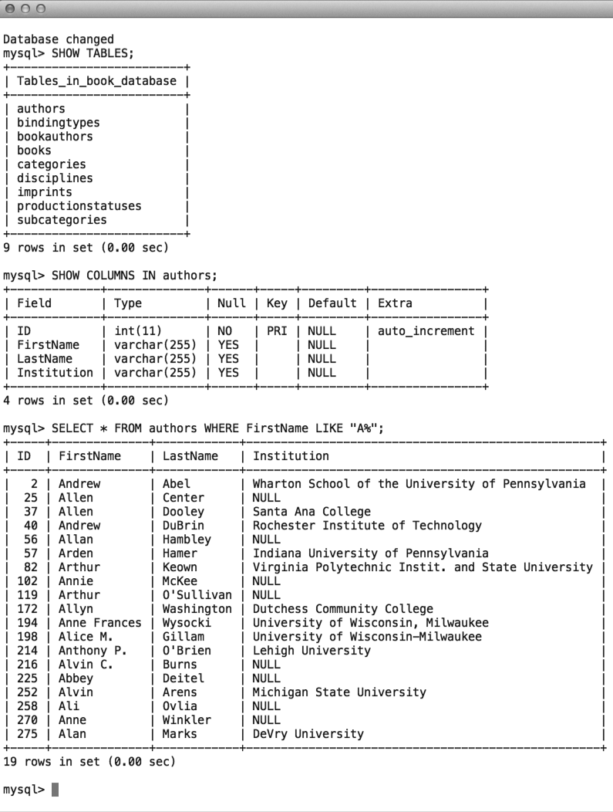
Managing a MySQL Database
Command-Line Interface

Slide 35
Managing a MySQL Database
Command-Line Interface
To launch an interactive MySQL command-line session, you must specify the host, username, and database name to connect to as shown below:
mysql -h 192.168.1.14 -u bookUser –p
To import commands from a file called commands.sql , for example, we would use the < operation:
mysql –h 192.168.1.14 –u bookUser –p < commands.sql

Slide 36
Managing a MySQL Database
phpMyAdmin

Slide 37
Managing a MySQL Database
MySQL Workbench

Slide 38
Chapter 14
1
Databases and Web Development
2
SQL
3
4
NoSQL
Database APIs
5
Managing a MySQL Database
6
Accessing MySQL in PHP
7
8
Sample Database Techniques
Case Study Schemas

Slide 39
Accessing MySQL in PHP
Basic Connection Algorithm
1. Connect to the database.
2. Handle connection errors.
3. Execute the SQL query.
4. Process the results.
5. Free resources and close connection.

Slide 40
Accessing MySQL in PHP
Basic Connection Algorithm

Slide 41
Accessing MySQL in PHP
Connecting to a Database (mysqli peocedural)
// modify these variables for your installation
$host = "localhost";
$database = "bookcrm";
$user = "testuser";
$pass = "mypassword";
$connection = mysqli_connect($host, $user, $pass, $database);

Slide 42
Accessing MySQL in PHP
Connecting to a Database (PDO Object-oriented)
// modify these variables for your installation
$connectionString = "mysql:host=localhost;dbname=bookcrm";
$user = "testuser";
$pass = "mypassword";
$pdo = new PDO($connectionString, $user, $pass);

Slide 43
Accessing MySQL in PHP
Handling Connection Errors - mysqli
$connection = mysqli_connect(DBHOST, DBUSER, DBPASS, DBNAME);
// mysqli_connect_errno returns the last error code
if ( mysqli_connect_errno() ) {
die( mysqli_connect_error() ); // die() is equivalent to exit()
}

Slide 44
Accessing MySQL in PHP
Handling Connection Errors - PDO
try {
$connString = "mysql:host=localhost;dbname=bookcrm";
$user = DBUSER;
$pass = DBPASS;
$pdo = new PDO($connString,$user,$pass);
. . .
}
catch (PDOException $e) {
die( $e->getMessage() );
}

Slide 45
Accessing MySQL in PHP
Executing the Query
$sql = "SELECT * FROM Categories ORDER BY CategoryName";
// returns a mysqli_result object
$result = mysqli_query($connection, $sql);
OR
$result = $pdo->query($sql);

Slide 46
Accessing MySQL in PHP
Processing the Query Results
$sql = "SELECT * FROM Categories ORDER BY CategoryName";
// run the query
$result = $pdo->query($sql);
// fetch a record from result set into an associative array
while ($row = $result->fetch()) {
// the keys match the field names from the table
echo $row['ID'] . " - " . $row['CategoryName'];
echo "<br/>";
}

Slide 47
Accessing MySQL in PHP
Processing the Query Results

Slide 48
Accessing MySQL in PHP
Freeing Resources and Closing Connection
//closes the connection
mysqli_close($connection);
// closes connection and frees the resources used by the PDO object
$pdo = null;

Slide 49
Accessing MySQL in PHP
Working with Parameters
$sql = "UPDATE Categories SET CategoryName='Web' WHERE
CategoryName='Business'";
$count = $pdo->exec($sql);
echo "<p>Updated " . $count . " rows</p>";

Slide 50
Accessing MySQL in PHP
Working with Parameters – Technique 1 ? Placeholders
$sql = "INSERT INTO books (ISBN10, Title, CopyrightYear, ImprintId,
ProductionStatusId, TrimSize, Description) VALUES (?,?,?,?,
?,?,?)";
$statement = $pdo->prepare($sql);
$statement->bindValue(1, $_POST['isbn']);
$statement->bindValue(2, $_POST['title']);
$statement->bindValue(3, $_POST['year']);
$statement->bindValue(4, $_POST['imprint']);
$statement->bindValue(5, $_POST['status']);
$statement->bindValue(6, $_POST['size']);
$statement->bindValue(7, $_POST['desc']);
$statement->execute();

Slide 51
Accessing MySQL in PHP
Working with Parameters – Technique 1 ? Placeholders with Array
/* can pass an array, to be used in order */
$sql = "INSERT INTO books (ISBN10, Title, CopyrightYear, ImprintId,
ProductionStatusId, TrimSize, Description) VALUES (?,?,?,?,
?,?,?)";
$statement = $pdo->prepare($sql);
$statement->execute array(array($_POST['isbn'], $_POST['title'],$_POST['year'], $_POST['imprint'], $_POST['status'], $_POST['size'],$_POST['desc']));

Slide 52
Accessing MySQL in PHP
Working with Parameters – Technique 2 - named parameters
$sql = "INSERT INTO books (ISBN10, Title, CopyrightYear, ImprintId,
ProductionStatusId, TrimSize, Description) VALUES (:isbn,
:title, :year, :imprint, :status, :size, :desc) ";
$statement = $pdo->prepare($sql);
$statement->bindValue(':isbn', $_POST['isbn']);
$statement->bindValue(':title', $_POST['title']);
$statement->bindValue(':year', $_POST['year']);
$statement->bindValue(':imprint', $_POST['imprint']);
$statement->bindValue(':status', $_POST['status']);
$statement->bindValue(':size', $_POST['size']);
$statement->bindValue(':desc', $_POST['desc']);
$statement->execute();

Slide 53
Accessing MySQL in PHP
Working with Parameters – Technique 2 - named parameters with Array
$sql = "INSERT INTO books (ISBN10, Title, CopyrightYear, ImprintId,
ProductionStatusId, TrimSize, Description) VALUES (:isbn,
:title, :year, :imprint, :status, :size, :desc) ";
$statement = $pdo->prepare($sql);
$statement->execute(array(':isbn' => $_POST['isbn'],
':title'=> $_POST['title'],
':year'=> $_POST['year'],
':imprint'=> $_POST['imprint'],
':status'=> $_POST['status'],
':size'=> $_POST['size']
':desc'=> $_POST['desc']));

Slide 54
Accessing MySQL in PHP
Getting user input into a query

Slide 55
Accessing MySQL in PHP
Using Transactions
$pdo = new PDO($connString,$user,$pass);
try {
// begin a transaction
$pdo->beginTransaction();
// a set of queries: if one fails, an exception will be thrown
$pdo->query("INSERT INTO Categories (CategoryName) VALUES ('Philosophy')");
$pdo->query("INSERT INTO Categories (CategoryName) VALUES ('Art')");
// if we arrive here, it means that no exception was thrown
$pdo->commit();
} catch (Exception $e) {
// we must rollback the transaction since an error occurred with insert
$pdo->rollback();
}

Slide 56
Accessing MySQL in PHP
Advanced example

Slide 57
Chapter 14
1
Databases and Web Development
2
SQL
3
4
NoSQL
Database APIs
5
Managing a MySQL Database
6
Accessing MySQL in PHP
7
8
Sample Database Techniques
Case Study Schemas

Slide 58
Case Study Schemas
Travel Photo Sharing Database

Slide 59
Case Study Schemas
Art Database

Slide 60
Case Study Schemas
Book CRM Database

Slide 61
Chapter 14
1
Databases and Web Development
2
SQL
3
NoSQL
4
Database APIs
5
Managing a MySQL Database
6
Accessing MySQL in PHP
7
8
Sample Database Techniques
Case Study Schemas

Slide 62
Chapter 14
1
Databases and Web Development
2
SQL
3
4
NoSQL
Database APIs
5
Managing a MySQL Database
6
Accessing MySQL in PHP
7
8
Sample Database Techniques
Case Study Schemas

Slide 63
Sample Database Techniques
Search and Results Page

Slide 64
Sample Database Techniques
Editing a Record

Slide 65
Sample Database Techniques
Editing a Record

Slide 66
Sample Database Techniques
Saving and Displaying Raw Files in the Database

Slide 67
Sample Database Techniques
Using BLOBs to store images

Slide 68
Sample Database Techniques
Headers matter

Slide 69
Chapter 14 cont.
9
Summary

Slide 70
Summary
Key Terms
abstraction layer
aggregate functions
binary tree
BLOB
column store
composite key
connection
connection string
database
database API
data integrity
data definition language (DDL)
data duplication
data manipulation language
database normalization
distributed transactions
document stores
field
foreign key
hash table
index
inner join
join
key-value stores
local transactions
many-to-many relationship
MySQL
named parameter
No-SQL database
object-oriented API
one-to-many relationship
one-to-one relationship
phpMyAdmin
prepared statement
primary key
procedural API
query
record
result set
sanitization
schema
SQL
SQL script
table
transaction
two-phase commit

Slide 71
Summary
Questions?

